Slide 1
DBS311: Advanced Database Services
Lecture 1 + 2 (Weeks 1,2)

Slide 2
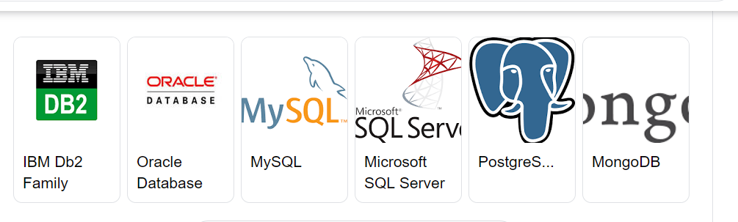
DBS311
Oracle accounts supplied
Examples presented with DB2

Slide 3
Number of Companies worldwide using DB2
with revenue above 1 billion – 6,585
with revenue 500m - 1 billion – 1,915
with revenue 50m – 500m – 7,228
with revenue 1m – 50m – 23,382
with revenue below 1m – 2,680
https://discovery.hgdata.com/product/ibm-db2

Slide 4
Agenda
Schedule
Review
Single Row Functions
First Lab

Slide 5
SQL
SQL: Structured Query Language
Designed specifically for communicating with databases
SQL functions fit into three broad categories:
DDL
Data Definition Language
DML
Data Manipulation Language
TCL
Transaction Control Language

Slide 6
SQL
Data definition language
SQL includes commands to create
Database objects such as tables
Commands to define access rights to those database objects
Data manipulation language
Includes commands to insert, update, delete, and retrieve data within the database tables objects
Transaction control language
Includes commands to ensure the integrity of the database. (Commit or Rollback)

Slide 7
SQL
American National Standards Institute (ANSI) prescribes a standard SQL
Several SQL dialects exist
DB2, Oracle, MySQL, Access etc

Slide 8
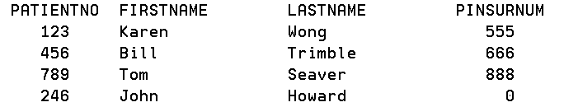
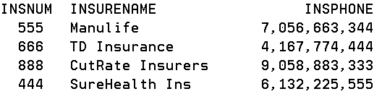
Joins
PATIENT
INSURANCE

Slide 9
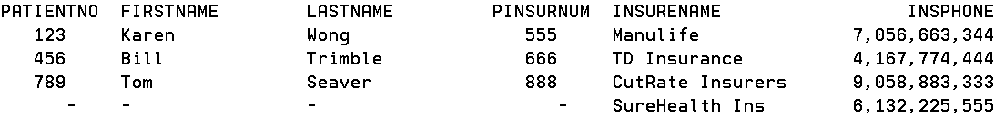
Joins
JOIN Example 1
JOIN Example 2

Slide 10
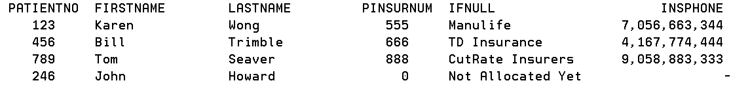
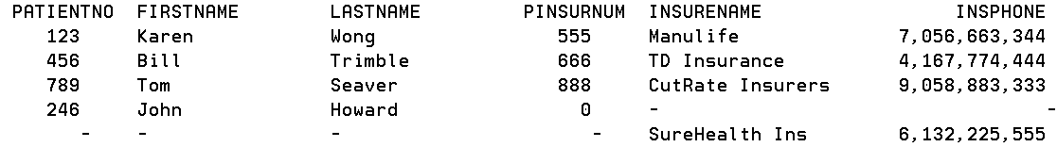
Joins
JOIN Example 3
JOIN Example 4

Slide 11
Joins
JOIN Example 5
Which patients do not have insurance
JOIN Example 6
What insurance company does not insure any patients at our hospital

Slide 12
Referential Integrity
No constraints have been included with the PATIENT and INSURANCE table creation
WHAT HAS TO HAPPEN FOR REFERENTIAL INTEGRITY TO BE ENFORCED?
Remove the patient row that refers to a non existent insurance company
What is the second step on the path to enforcing referential integrity?
Make the insurance number the primary key for the insurance table
What is the third step?
Create a foreign key for insurance number in the PATIENT table

Slide 13
Single Row Functions & Variables
Character Functions
Numeric Functions
Datetime Functions
Conversion Functions
General Comparison Functions
Assigning Variables

Slide 14
SQL Functions
There are two types of functions:
Single-row
Multiple-row
A single-row function returns one result for each row. These functions operate on single rows only and return one result for every row acted on.
A multiple-row function returns one result per set of rows. Functions can manipulate groups of rows to give one result per group of rows. These functions are also called group functions.

Slide 15
SQL Functions
Single-row functions return a single result for each row in the result set.
Single-row functions can be used in
SELECT
WHERE
HAVING
ORDER BY
Functions can be used to
Perform calculations on data
Modify individual data items
Manipulate output for groups of rows
Format dates and numbers for display
Convert column data types
SQL functions may take arguments and always return a value.

Slide 16
Single Row Functions
These functions manipulate data items
Used in one or more arguments and return a single value for each row that is retrieved by the query
An argument can be one of the following:
User supplied constant
Variable value
Column name
Expression

Slide 17
Single Row Functions
The actions of a single row function include:
Acts on each row that is returned by the query
Returns one result per row
May possibly return a different data type than the one that is referenced
The function expects one or more arguments
Let us look at Character Functions

Slide 18
Character Functions
These functions accept character type arguments and return character or numeric values
Character Functions
LOWER
UPPER
INITCAP
Character manipulation
SUBSTR
CONCAT
LENGTH
INSTR
TRIM
REPLACE

Slide 19
Case Manipulation Functions
Function | Returning Result
LOWER(‘DATABASE systems’) | database systems
UPPER(‘DATABASE systems’) | DATABASE SYSTEMS
INITCAP(‘DATABASE systems’) | Database Systems

Slide 20
Case Manipulation Functions
LOWER()
returns the character argument with all lower case letters.
UPPER()
returns the character argument with all upper case letters.
INITCAP()
returns each word with the first letter capital and other letters lower case.
Words are delimited by white space or characters that are not alphanumeric.

Slide 21
Case Manipulation Functions
Function | Returning Result
CONCAT(‘Database’, ‘Systems’) | DatabaseSystems
SUBSTR (‘DatabaseSystems’,1,4) | Data
LENGTH(‘DatabaseSystems’) | 15
INSTR(‘DatabaseSystems’, ‘b’) | 5
LPAD(‘Tommy’, 10, ‘*’) | *****Tommy
RPAD(‘Tommy’, 10, ‘*’) | Tommy*****
REPLACE(‘Jack and Jue’, ‘J’, ‘Bl’) | Black and Blue
TRIM(‘D’ FROM ‘Database’) | atabase
NVL(<column>,<replacement> | Replaces NULL with <rep> in <col>

Slide 22
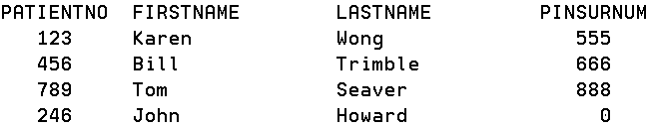
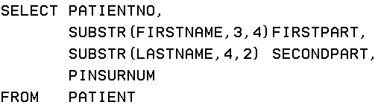
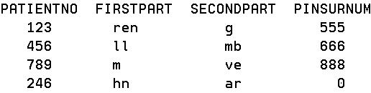
SUBSTR

Slide 23
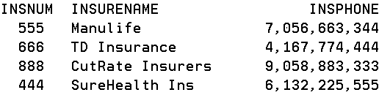
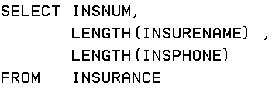
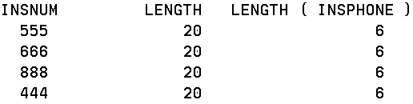
LENGTH

Slide 24
WHY 6 FOR PHONE ?
EBCDIC representation
NUMERIC OR ZONED
F1 F1 F1 F1 F1 F1 F1 F1 F1 F1
DECIMAL OR PACKED
1 11 11 11 11 1F
F1 broken down into bits is 1111 0001
F1 displays as a 1 in all interfaces
11 doesn’t display very well in some interfaces

Slide 25
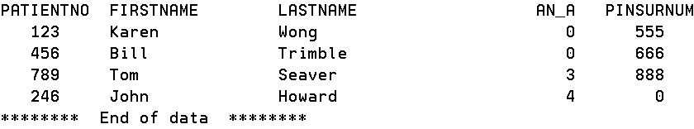
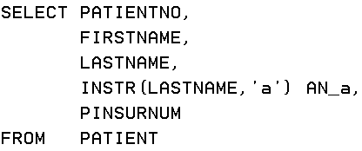
INSTR
The INSTR function returns the starting position of a string (called the search-string) within another string (called the source-string). If the search-string is not found and neither argument is null, the result is zero.
If the search-string is found, the result is a number from 1 to the actual length of the source-string.

Slide 26
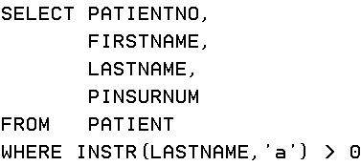
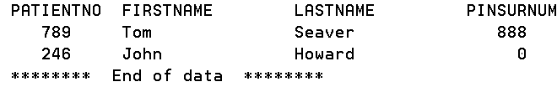
INSTR in a different clause
We can move the function from the Select clause to a different clause
Patients who have an a in their last name

Slide 27
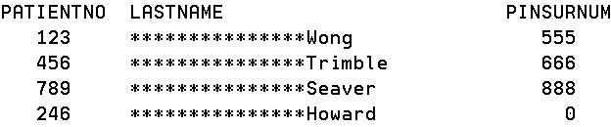
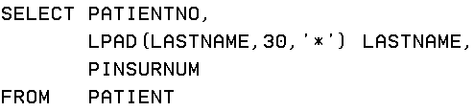
LPAD
The LPAD function returns a string composed of expression that is padded on the left.
The LPAD function treats leading or trailing blanks in expression as significant. Padding will only occur if the actual length of expression is less than length, and pad is not an empty string.

Slide 28
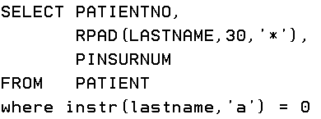

RPAD
Right pad up to 30 characters with * all the last names without an ‘a’ anywhere in the name

Slide 29
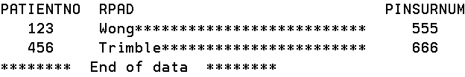
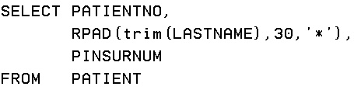
Fixing our RPAD
You really wanted this:
How can you achieve this?
Use the Trim character manipulation function
The TRIM function removes blanks or another specified character from the end, from the beginning, or from both of a string expression

Slide 30
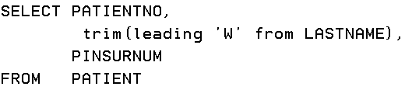
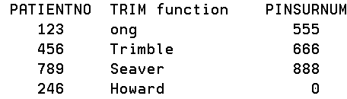
TRIM
The first argument, if specified, indicates whether characters are removed from the end or beginning of the string. If the first argument is not specified, then the characters are removed from both the end and the beginning of the string.
TRIM (<BOTH><LEADING><TRAILING> strip character FROM argument

Slide 31
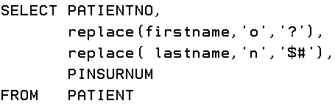
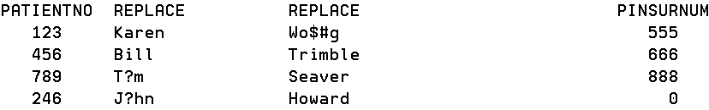
REPLACE
The REPLACE function replaces all occurrences of search-string in source-string with replace-string. If search-string is not found in source-string, source-string is returned unchanged.

Slide 32
Numeric Functions
Function | Returning Result
ROUND(5.678, 2) | 5.68
TRUNC(5.678, 2) | 5.67
MOD(10, 3) | 1
ROUND(v, n)
It receives two arguments
v is a value of any numeric type
n is an integer value
returns the argument value v rounded to n places to the right of the decimal point.
If you use 0 or no value for the second argument, n is rounded to 0 decimal places
ROUND(22.96) → 23

Slide 33
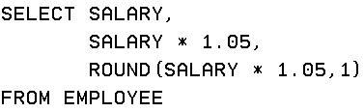
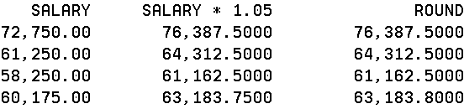
ROUND()
DB2

Slide 34
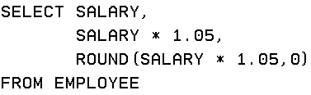
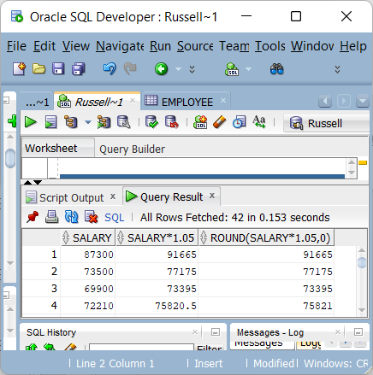
ROUND (ORACLE)

Slide 35
TRUNC()
TRUNC(v,n)
truncates a number v to n decimal places
TRUNC(15.193, 2) → 15.19
TRUNC(15.193, 3) → 15.193
TRUNC(15.193, 1) →15.1
TRUNC(n)
truncate a number n to zero decimal places.
TRUNC(15.193) → 15

Slide 36
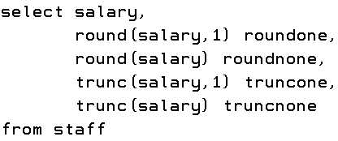
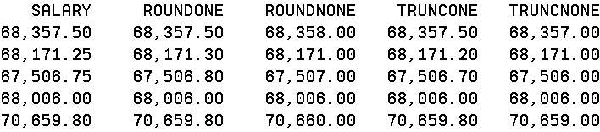
Number Functions

Slide 37
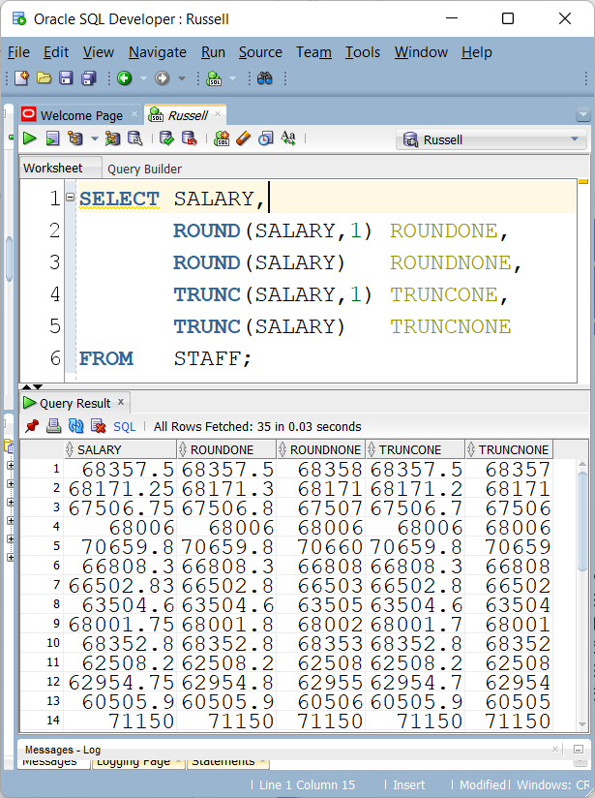
Using Oracle

Slide 38
MOD()
The MOD function divides the first argument by the second argument and returns the remainder
MOD(121,14) → 9
MOD(25, 7) → 4
The MOD() function is used to determine if a number is odd or even

Slide 39




MOD()

Slide 40
Datetime Functions
DATES
The default display and input format for any date is DD-MON-RR. Valid Oracle dates are between January 1, 4712 B.C., and December 31, 9999 A.D. • In the example in the slide, the HIRE_DATE column output is displayed in the default format DD-MON-RR. However, dates are not stored in the database in this format. All the components of the date and time are stored. So, although a HIRE_DATE such as 17-JUN-87 is displayed as day, month, and year, there is also time and century information associated with the date. The complete data might be June 17, 1987, 5:10:43 p.m.
CENTURY YEAR MONTH DAY HOUR MINUTE SECOND
19 87 06 17 17 10 43 • Note: century or year stored as 4 digits even if displayed as 2

Slide 41
ORACLE USES SYSDATE
SYSDATE returns current
Date
Time
SELECT SYSDATE
FROM DUAL
22-09-11
11-SEP-22
Since Oracle database stores dates as numbers, arithmetic operations such as addition or subtraction can be performed on date values. You can add or subtract both numbers and dates to or from date values.
Date + Number
Date – Number
Date – Date

Slide 42
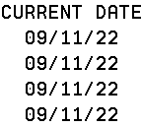
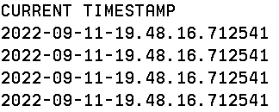

DB2
SELECT CURRENT DATE FROM STAFF
SELECT CURRENT TIMESTAMP FROM STAFF
FETCH FIRST ROW ONLY

Slide 43



Date Arithmetic
DB2
ORACLE

Slide 44
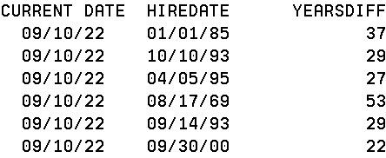
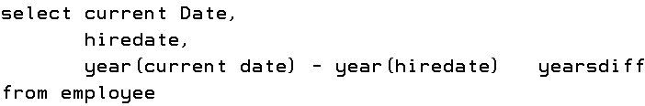
Date Arithmetic
DB2 – how many years has an employee been at company

Slide 45
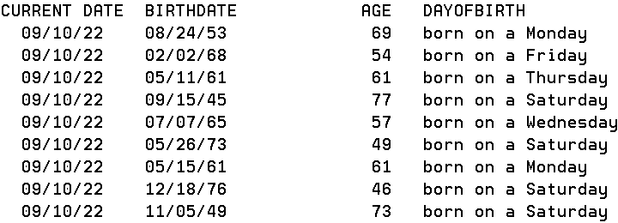
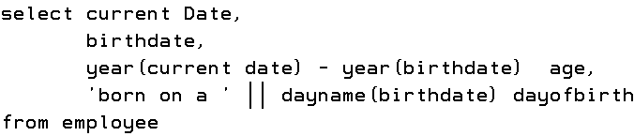
Date Arithmetic and DayName
DB2 – How old is an employee

Slide 46
Conversion Functions
Conversions are about changing the data type of a column.
This may be required to bridge between one SQL statement and another – or – to bridge between the way an application works versus the way a database is designed (for example: application performs an arithmetic operation on numerical values stored as a CHAR or VARCHAR in the datebase)
This cannot be performed in an ALTER TABLE
This is about changing the data type in a result set
Some data types allow for conversions, some conditionally allow for conversions and some do not.
An example of a valid data type conversion, which will always work: INTEGER to CHAR/VARCHAR
An example of a valid data type conversion, which may not work: CHAR/VARCHAR to INTEGER
An example of a valid data type conversion, which may produce a warning: VARCHAR to CHAR
An example of an invalid data type conversion: INTEGER to BINARY

Slide 47

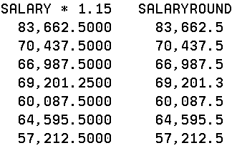
CAST

Slide 48

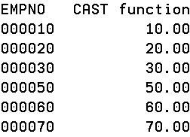
CAST
EMPNO is character, change to decimal

Slide 49

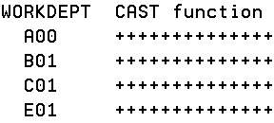
CAST
A cast fails

Slide 50
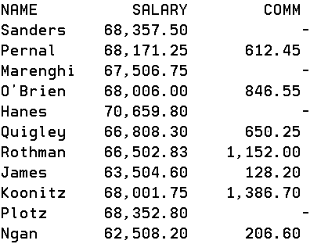
DB2 IFNULL, ORACLE NVAL
When selecting the employee name, salary and commission, if the commission is missing (that is, null), then return a value of zero with IFNULL.
In DB2 null is shown as a dash

Slide 51
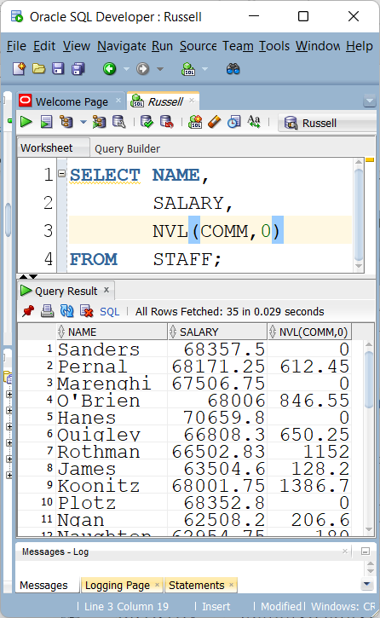
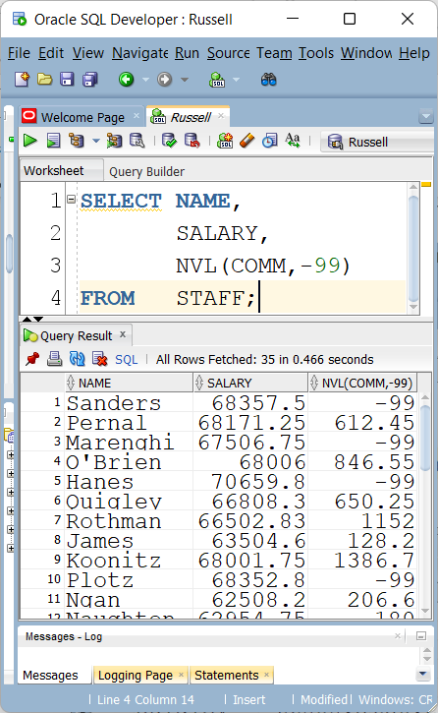
NVAL

Slide 52
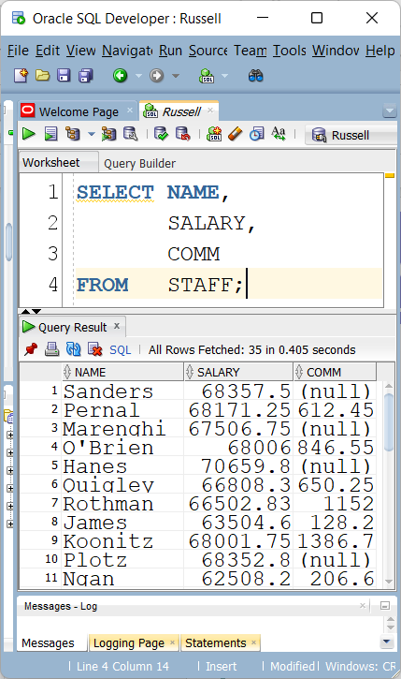
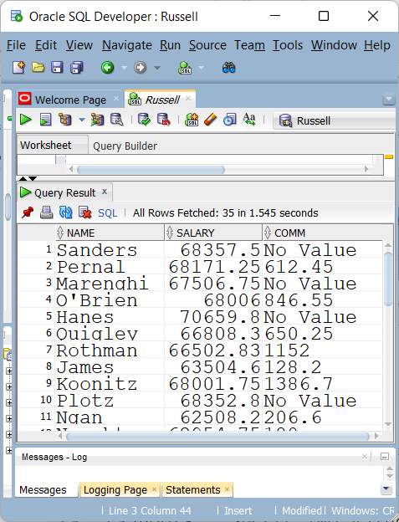
Using NVL

Slide 53
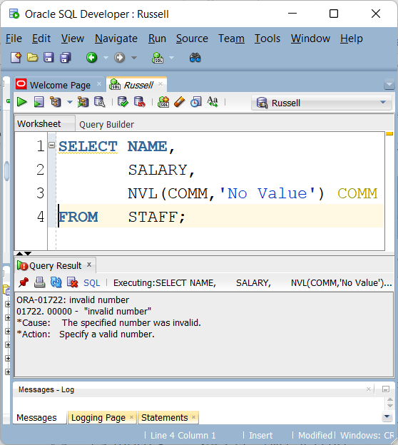
NVL on a numeric field

Slide 54
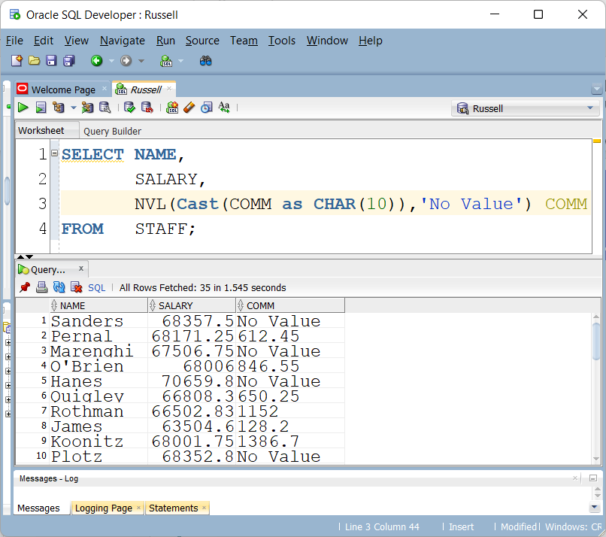
Solve using Cast

Slide 55
General Comparison Functions
Comparison functions allow for two or more values to be compared during a SQL statement to help define the desired result set. There is a large set of comparison functions.
>, <=, >=, =, !=, <>
AND
OR
IN
BETWEEN
NOT BETWEEN
LIKE
NOT LIKE
IS
IS NOT

Slide 56


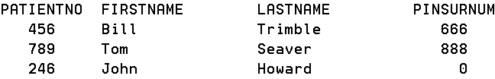
Not equal to
Results in

Slide 57
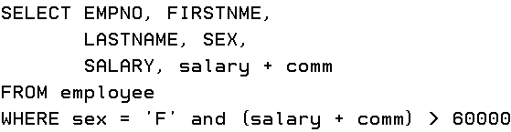

What is the difference?

Slide 58


IN

Slide 59


NOT

Slide 60


BETWEEN

Slide 61



LIKE and %
SELECT LASTNAME FROM EMPLOYEE
WHERE LASTNAME LIKE '%A’

Slide 62


LIKE and %
Anybody that has a last name that begins with an A
Anybody that has a last name that has an A somewhere in the name

Slide 63


NULL

Slide 64



ASSIGNING VARIABLES
Oracle would not require the use of the schema name – DBS311

Slide 65
Lab 1
Lab 1 already uploaded and Powerpoint will be uploaded sometime tonight.

